Slide 1


Music Store Analysis

Slide 2

Objective
This project aims to analyse a digital music store database using SQL, with a focus on delivering valuable insights to stakeholders for informed decision-making.
Through comprehensive SQL queries, the project explores various aspects, including geographic expansion, purchasing trends, total revenue, genre performance, and the popularity of music bands.
By addressing both straightforward and complex queries, the analysis provides actionable recommendations to enhance business growth and optimize overall performance.

Slide 3
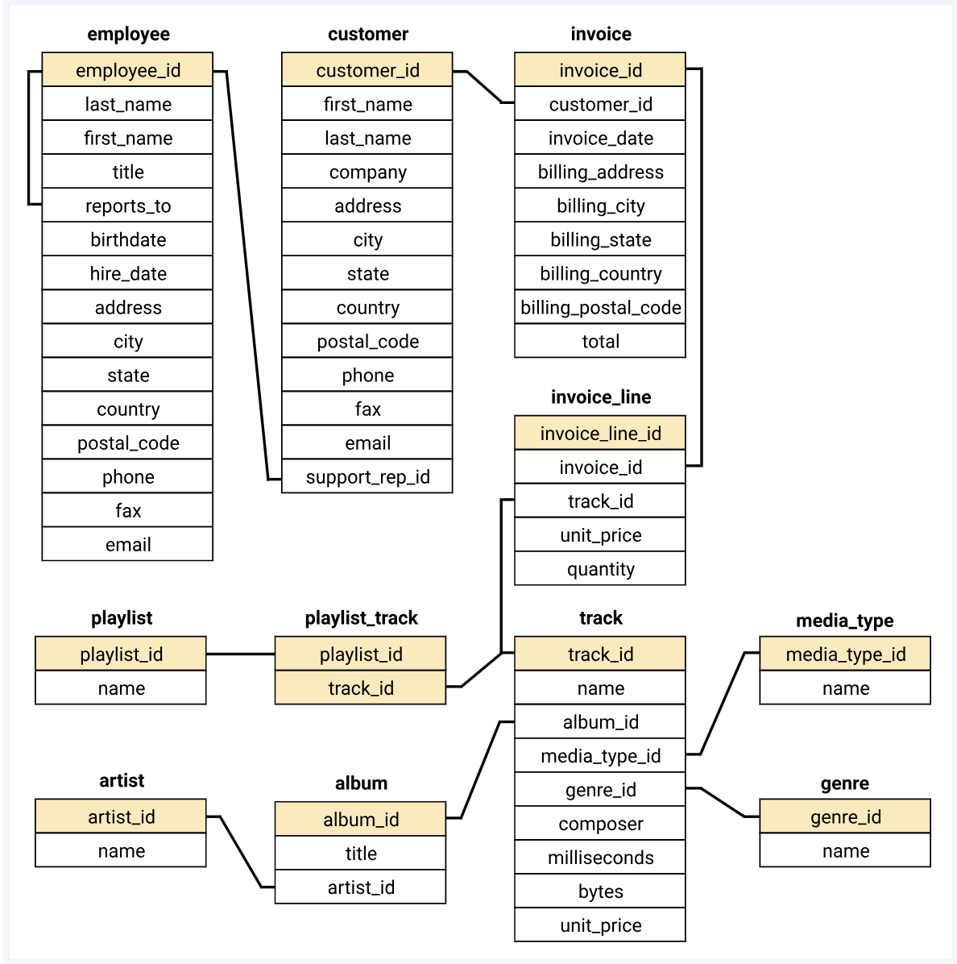
Database Schema

Slide 4

Query Complexity Levels
01
02
03
Easy
Moderate
Advanced
Select
Group By Order By
Limit Asc/Desc
Joins
Order By
Group By
Limits
CTE (Common Table Expressions)
Recursion

Slide 5


1
Easy

Slide 6
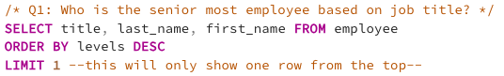
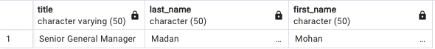
Query
Q1. Who is the senior most employee based on job title?
Output

Slide 7
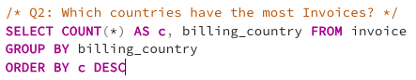
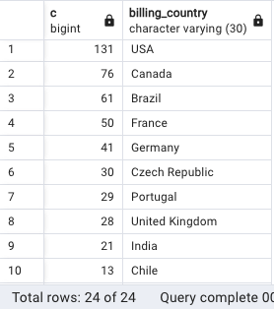
Q2. Which countries have the most Invoices?
Query
Output

Slide 8
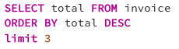
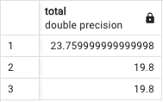
Query
Q3. What are top 3 values of total invoice
Output

Slide 9
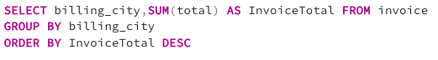
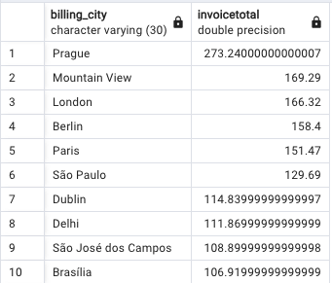
Q4. Which city has the best customers? We would like to throw a promotional Music Festival in the city we made the most money. Write a query that returns one city that has the highest sum of invoice totals. Return both the city name & sum of all invoice totals
Query
Output

Slide 10
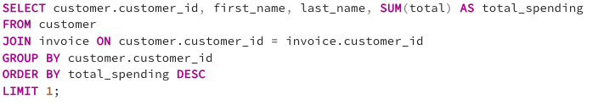
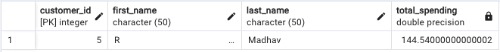
Q5. Who is the best customer? The customer who has spent the most money will be declared the best customer. Write a query that returns the person who has spent the most money
Query
Output

Slide 11
2
Moderate

Slide 12
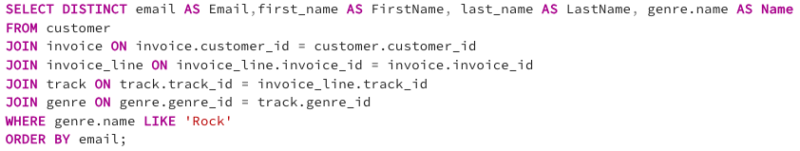
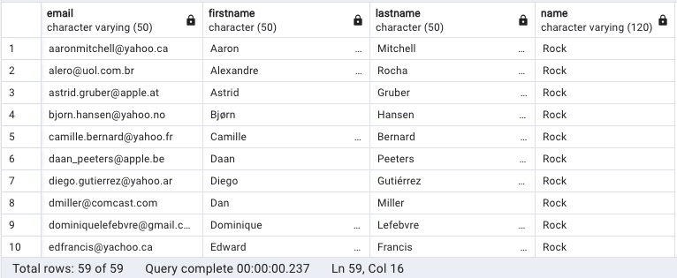
Q1. Write query to return the email, first name, last name, & Genre of all Rock Music listeners. Return your list ordered alphabetically by email starting with A
Query
Output

Slide 13
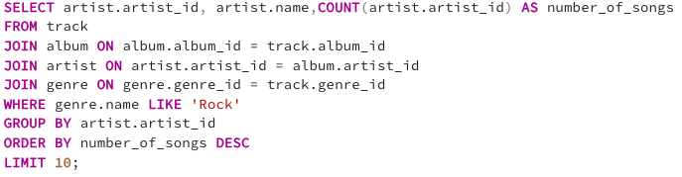
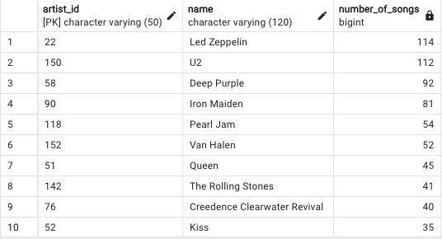
Q2. Let's invite the artists who have written the most rock music in our dataset. Write a query that returns the Artist name and total track count of the top 10 rock bands
Query
Output

Slide 14
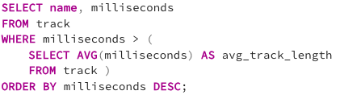
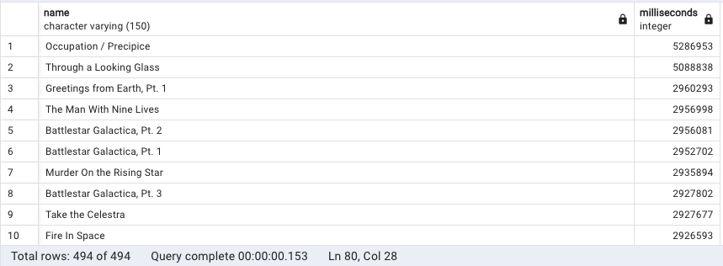
Query
Q3. Return all the track names that have a song length longer than the average song length. Return the Name and Milliseconds for each track. Order by the song length with the longest songs listed first
Output

Slide 15
3
Advanced

Slide 16
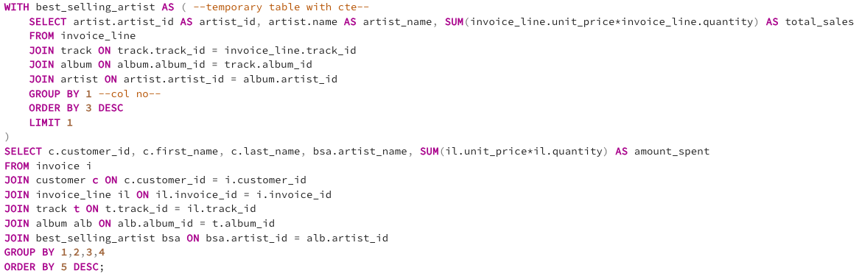
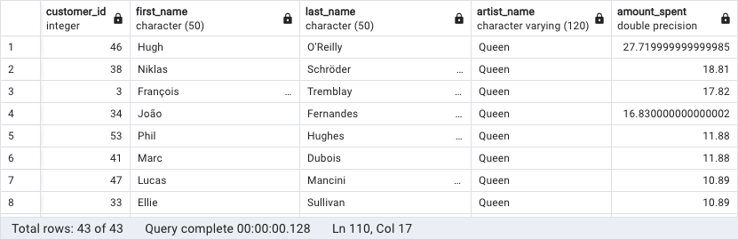
Query
Q1. Find how much amount spent by each customer on artists? Write a query to return customer name, artist name and total spent.
Output

Slide 17
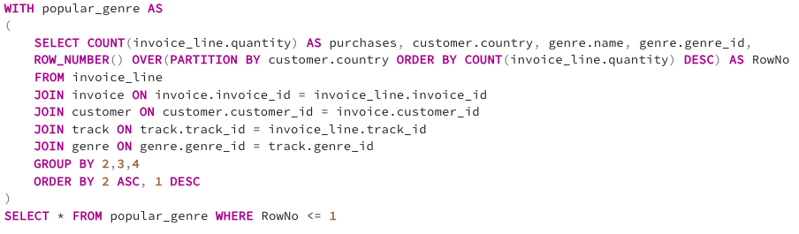
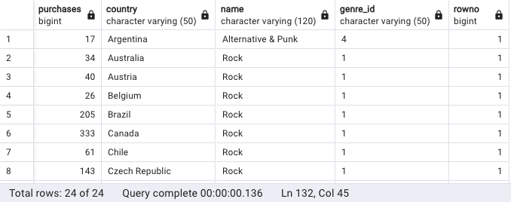
Q2. We want to find out the most popular music Genre for each country. We determine the most popular genre as the genre with the highest amount of purchases. Write a query that returns each country along with the top Genre. For countries where the maximum number of purchases is shared return all Genres
Query
Output

Slide 18
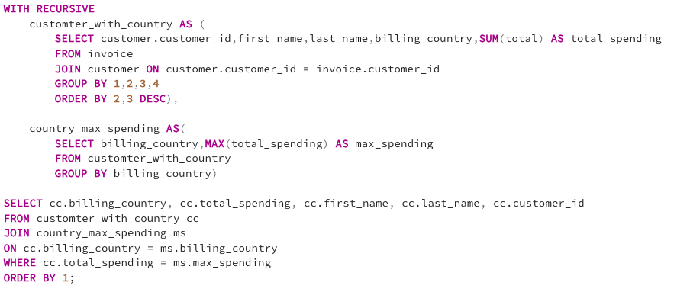
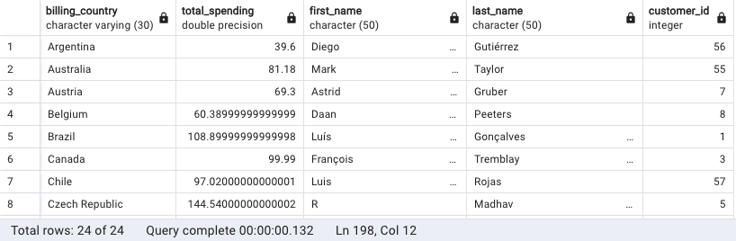
Query
Q3. Write a query that determines the customer that has spent the most on music for each country. Write a query that returns the country along with the top customer and how much they spent. For countries where the top amount spent is shared, provide all customers who spent this amount
Output

Slide 19


Thank You!

